Slide 1
Semiotics of Clean
Automated Insights Report
May 2025

Slide 2
STUDY OVERVIEW
• Status
Completed on: 04/03/2025
• Surveys Started
04/03/2025
• Surveys Completed
50 (out of 50)

Slide 3
Overall (Top Down)
Consumer Insights Analysis

Slide 4
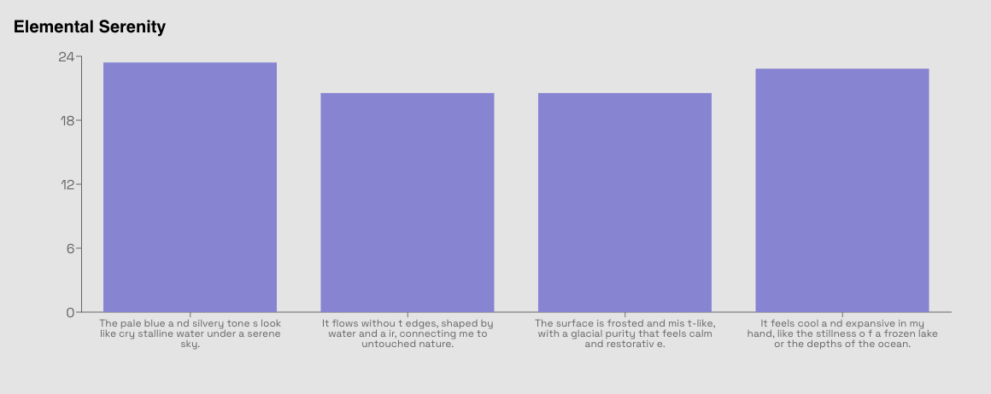
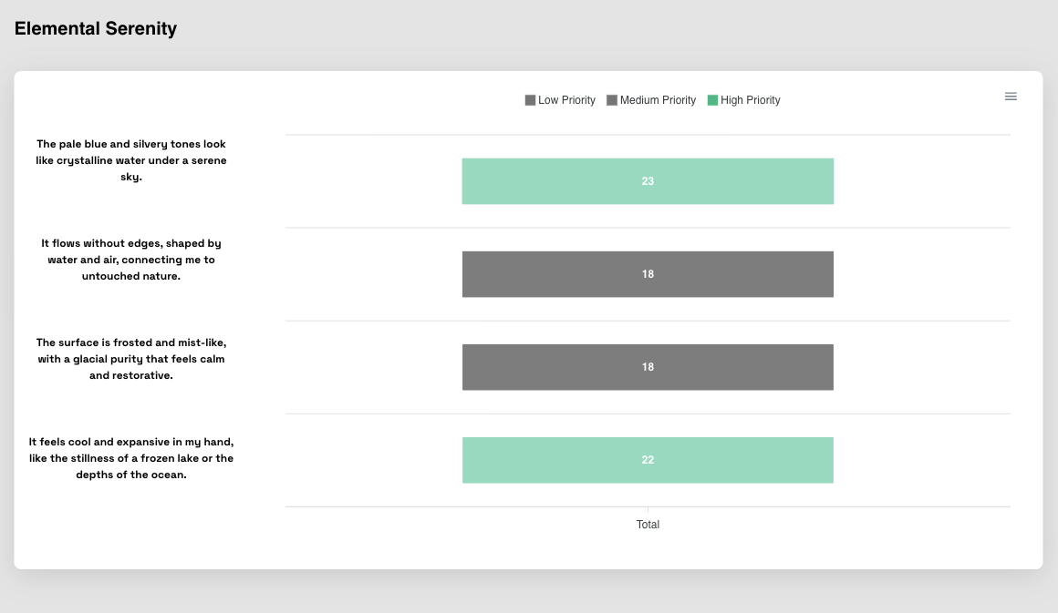
Overall | Top Down
Elemental Serenity
Key Findings:
• Preferred highest: 23.0 (The pale blue and silvery tones look like crystalline water under a serene sky.)
• Preferred lowest: 18.0 (Least preferred)
• Preferred average: 20.2 (Average)
• Summary: 23.0 performed best in The pale blue and silvery tones look like crystalline water under a serene sky. (Excellent preferred)
© mindgenome.org

Slide 5
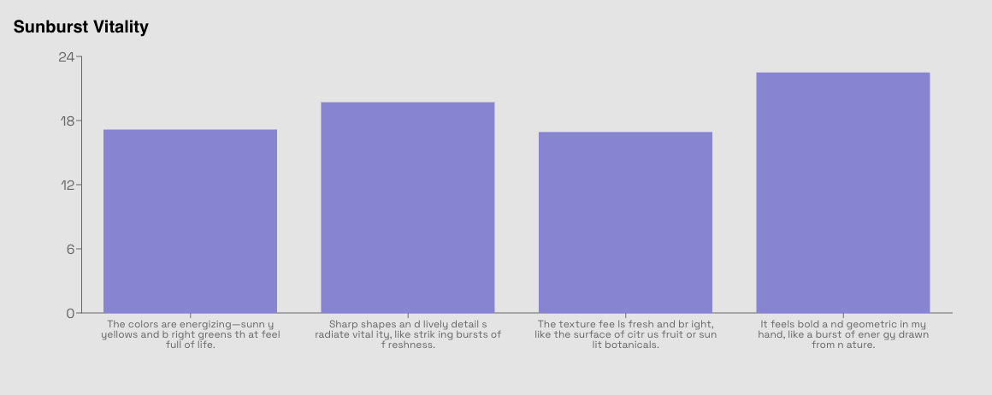
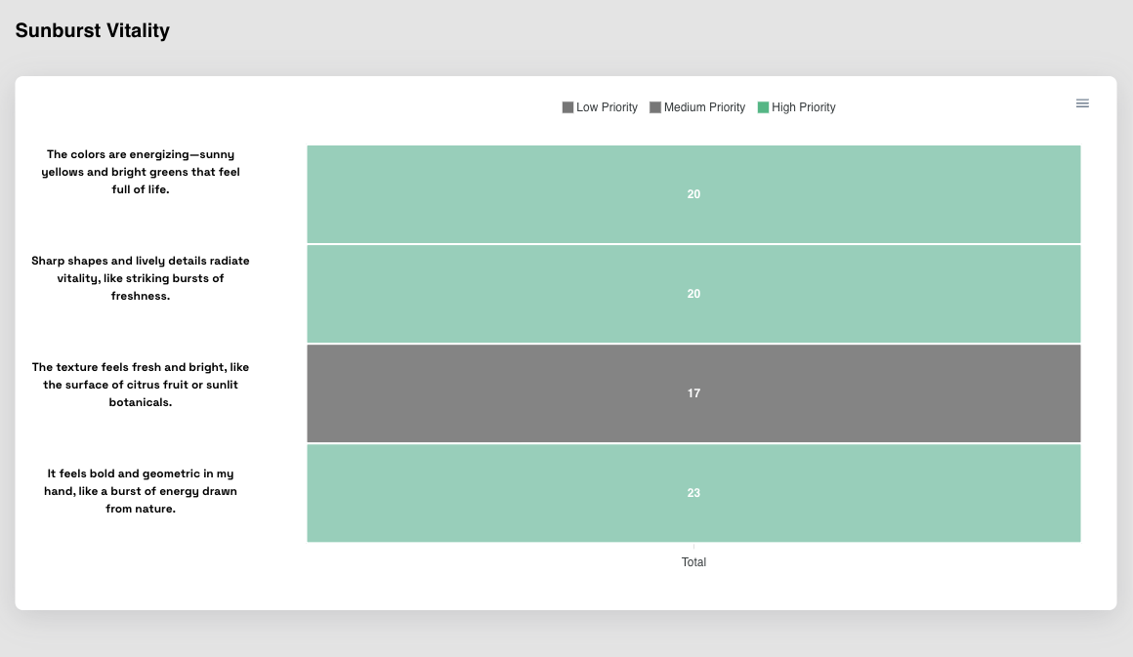
Overall | Top Down
Sunburst Vitality
Key Findings:
• Preferred highest: 23.0 (It feels bold and geometric in my hand, like a burst of energy drawn from nature.)
• Preferred lowest: 17.0 (Least preferred)
• Preferred average: 20.0 (Average)
• Summary: 23.0 performed best in It feels bold and geometric in my hand, like a burst of energy drawn from nature. (Excellent preferred)
© mindgenome.org

Slide 6
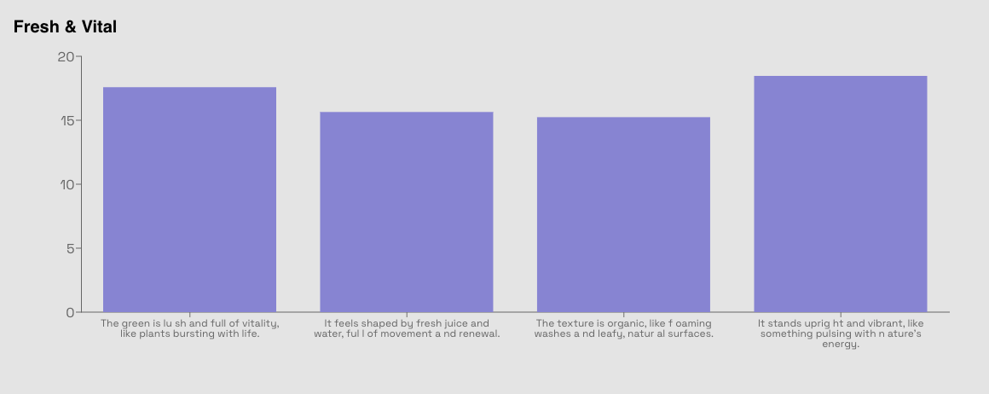
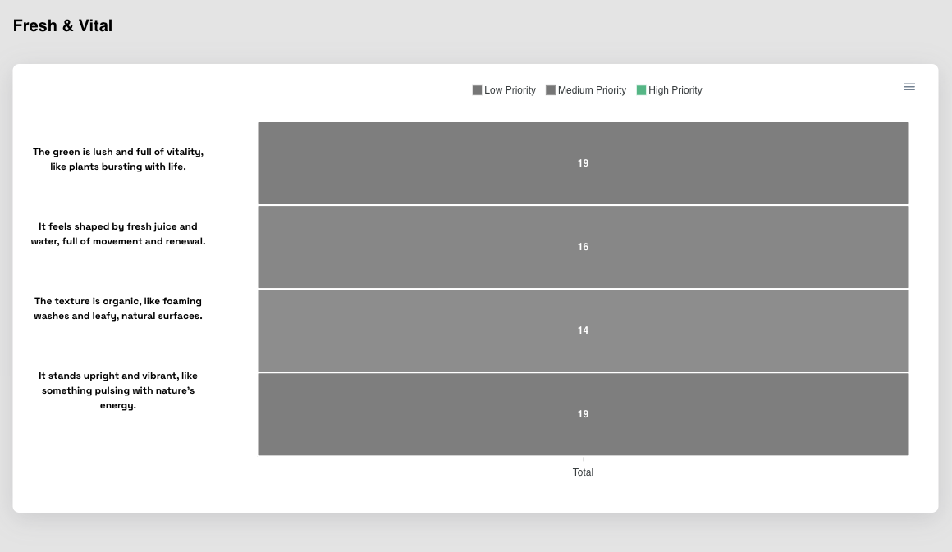
Overall | Top Down
Fresh & Vital
Key Findings:
• Preferred highest: 19.0 (It stands upright and vibrant, like something pulsing with nature’s energy.)
• Preferred lowest: 14.0 (Least preferred)
• Preferred average: 17.0 (Average)
• Summary: 19.0 performed best in It stands upright and vibrant, like something pulsing with nature’s energy. (Excellent preferred)
© mindgenome.org

Slide 7
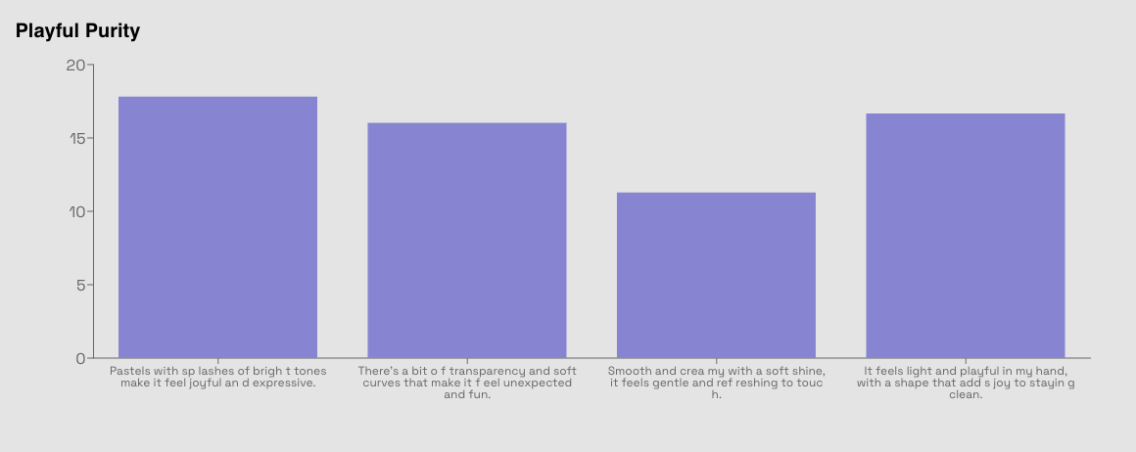
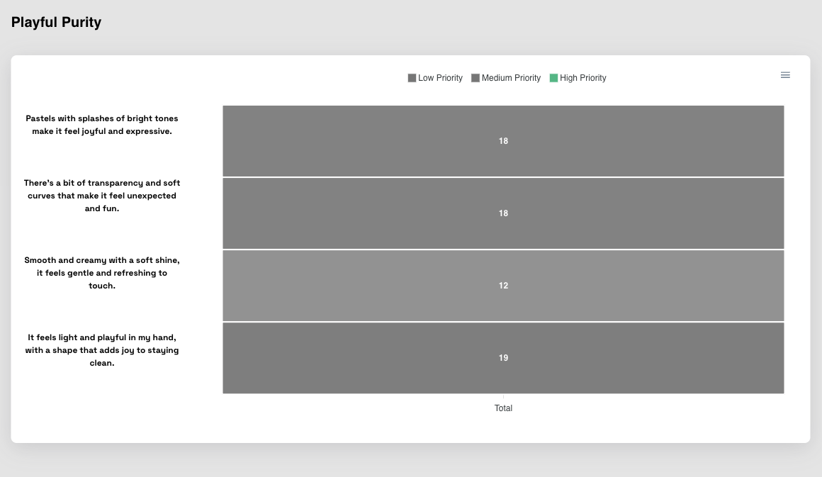
Overall | Top Down
Playful Purity
Key Findings:
• Preferred highest: 19.0 (It feels light and playful in my hand, with a shape that adds joy to staying clean.)
• Preferred lowest: 12.0 (Least preferred)
• Preferred average: 16.8 (Average)
• Summary: 19.0 performed best in It feels light and playful in my hand, with a shape that adds joy to staying clean. (Excellent preferred)
© mindgenome.org

Slide 8
Overall (Bottom Up)
Consumer Insights Analysis

Slide 9
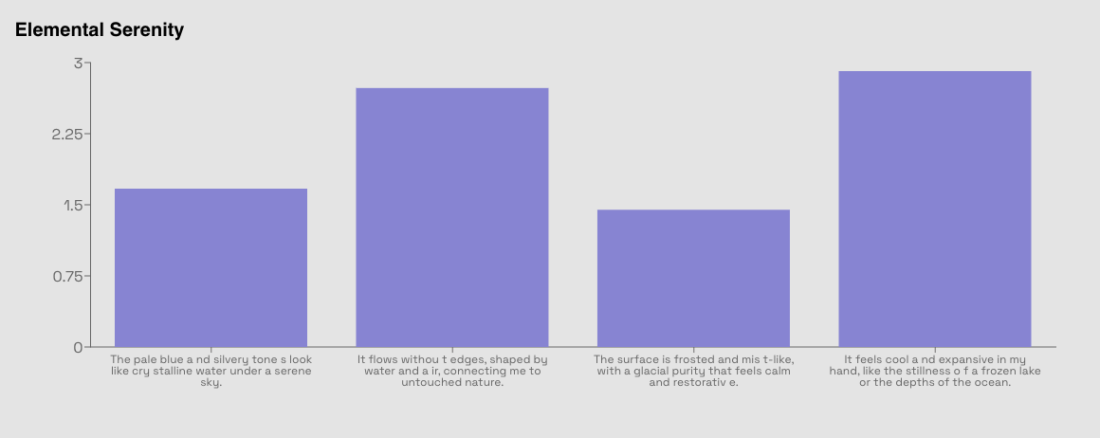
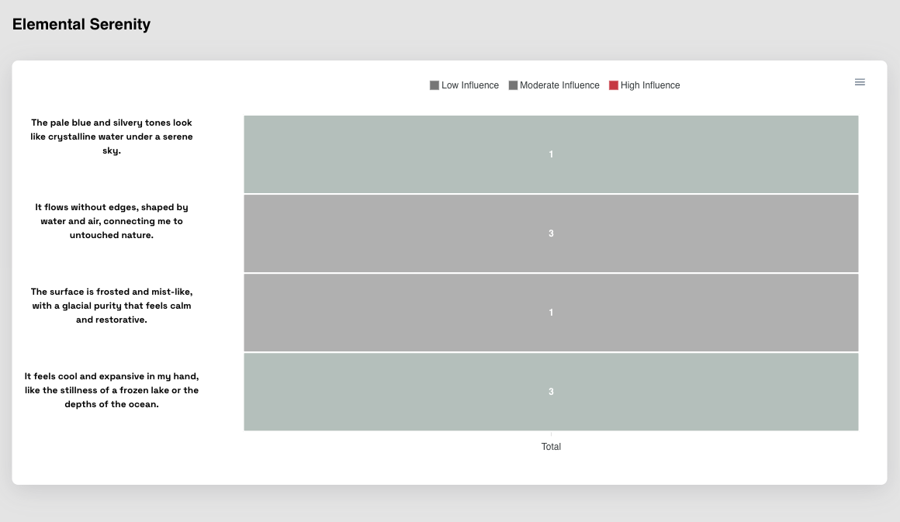
Overall | Bottom Up
Elemental Serenity
Key Findings:
• Preferred highest: 3.0 (It feels cool and expansive in my hand, like the stillness of a frozen lake or the depths of the ocean.)
• Preferred lowest: 1.0 (Least preferred)
• Preferred average: 2.0 (Average)
• Summary: 3.0 performed best in It feels cool and expansive in my hand, like the stillness of a frozen lake or the depths of the ocean. (Excellent preferred)
© mindgenome.org

Slide 10
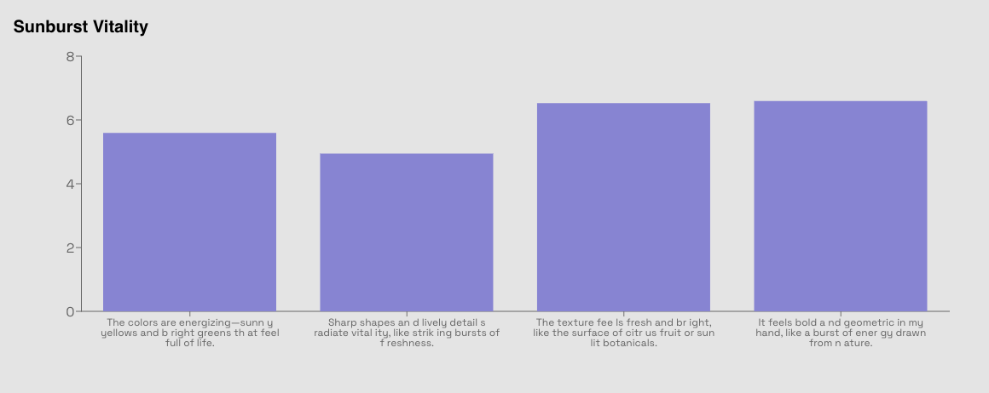
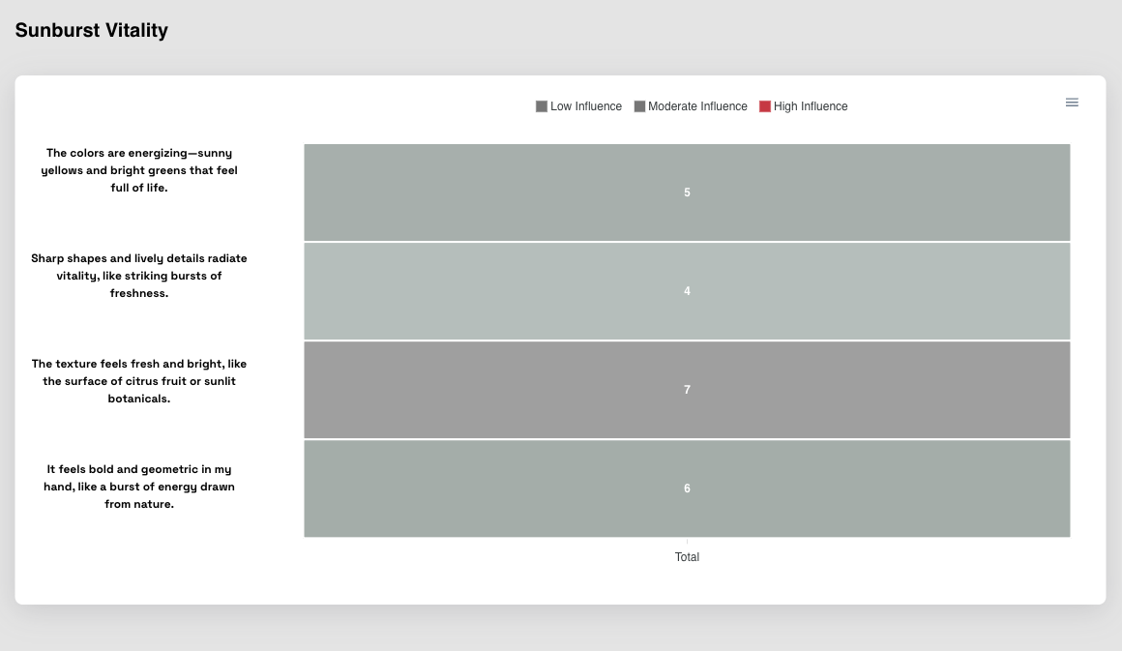
Overall | Bottom Up
Sunburst Vitality
Key Findings:
• Preferred highest: 7.0 (The texture feels fresh and bright, like the surface of citrus fruit or sunlit botanicals.)
• Preferred lowest: 4.0 (Least preferred)
• Preferred average: 5.5 (Average)
• Summary: 7.0 performed best in The texture feels fresh and bright, like the surface of citrus fruit or sunlit botanicals. (Excellent preferred)
© mindgenome.org

Slide 11
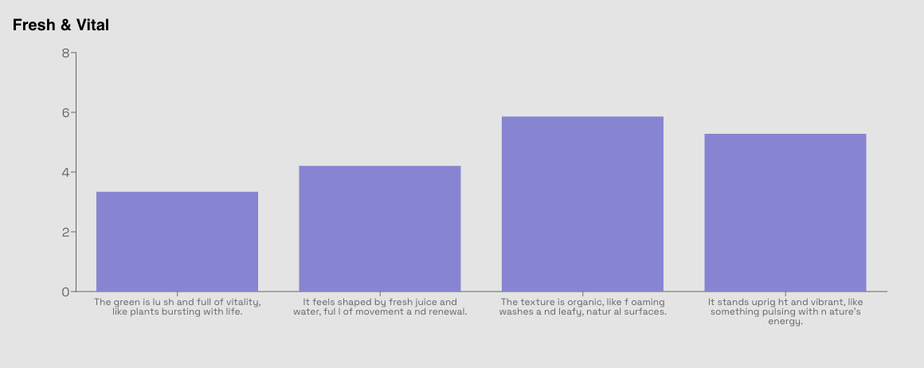
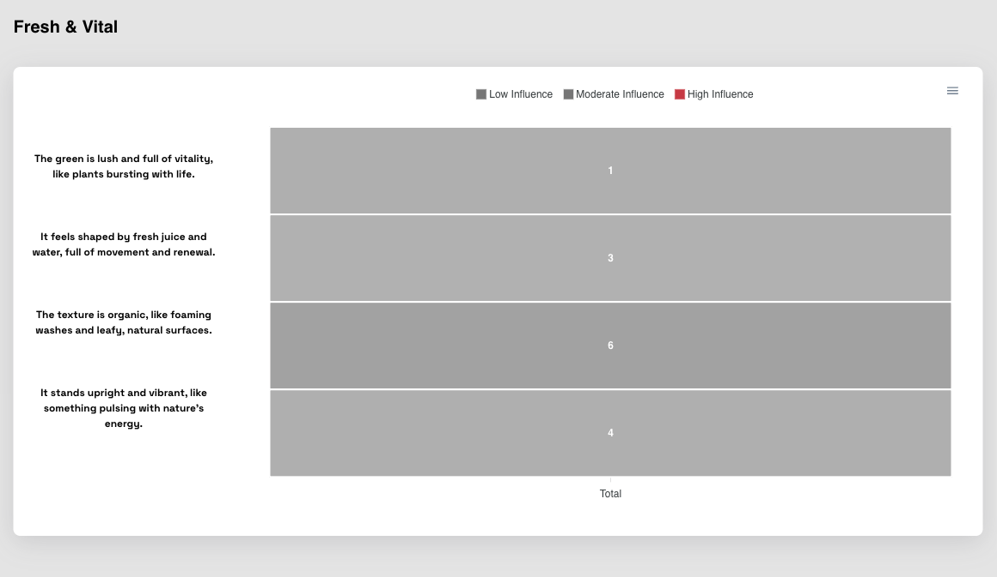
Overall | Bottom Up
Fresh & Vital
Key Findings:
• Preferred highest: 6.0 (The texture is organic, like foaming washes and leafy, natural surfaces.)
• Preferred lowest: 1.0 (Least preferred)
• Preferred average: 3.5 (Average)
• Summary: 6.0 performed best in The texture is organic, like foaming washes and leafy, natural surfaces. (Excellent preferred)
© mindgenome.org

Slide 12
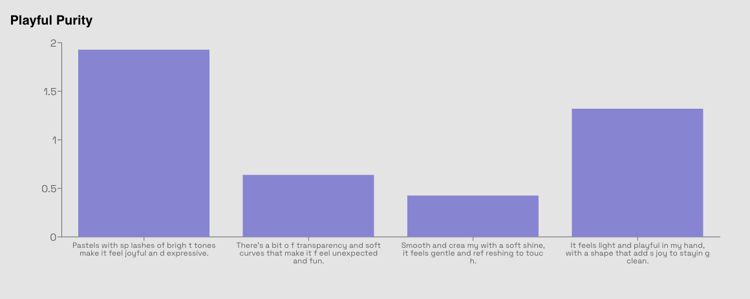
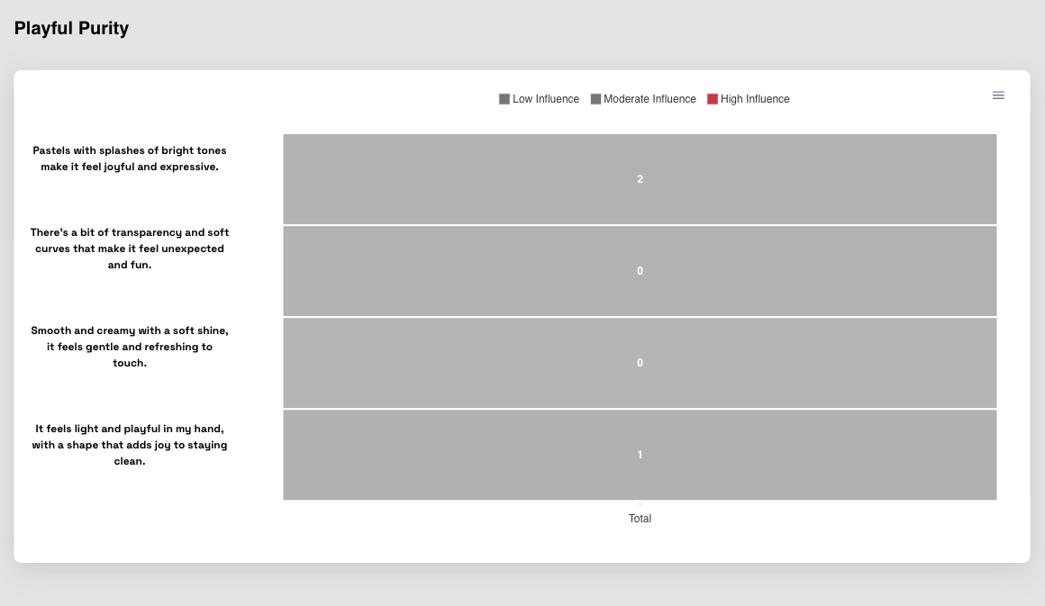
Overall | Bottom Up
Playful Purity
Key Findings:
• Preferred highest: 2.0 (Pastels with splashes of bright tones make it feel joyful and expressive.)
• Preferred lowest: 0.0 (Least preferred)
• Preferred average: 0.8 (Average)
• Summary: 2.0 performed best in Pastels with splashes of bright tones make it feel joyful and expressive. (Excellent preferred)
© mindgenome.org

Slide 13
Overall (Response Time)
Consumer Insights Analysis

Slide 14
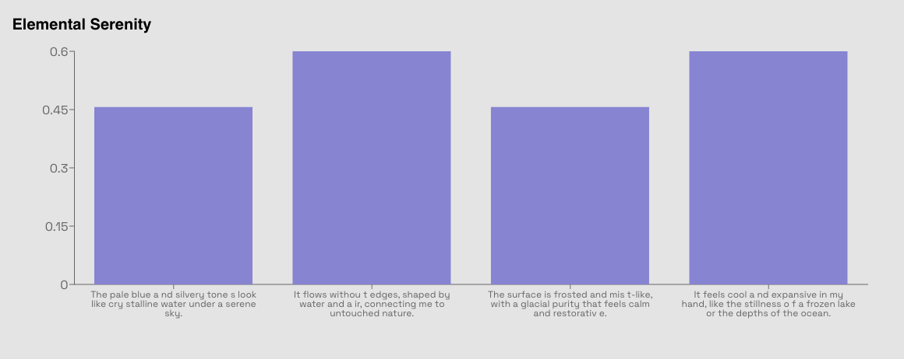
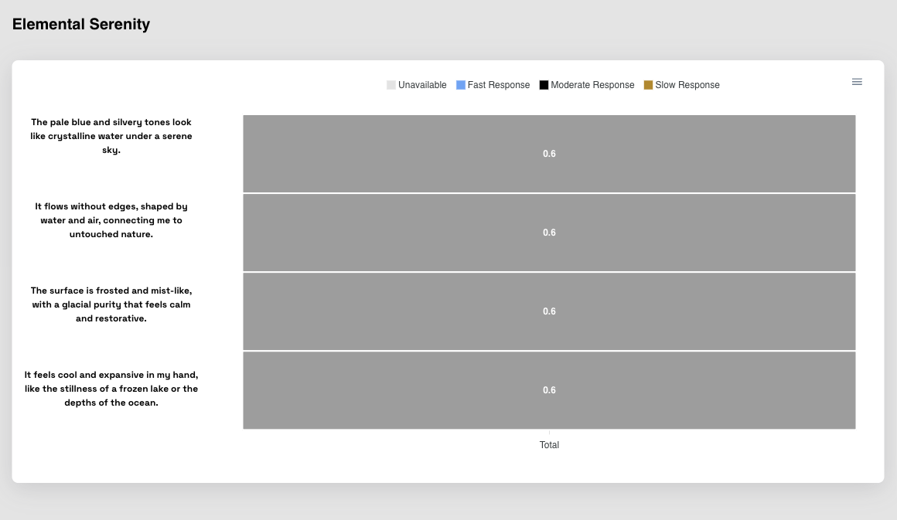
Overall | Response Time
Elemental Serenity
Key Findings:
• Preferred highest: 0.6 (It feels cool and expansive in my hand, like the stillness of a frozen lake or the depths of the ocean.)
• Preferred lowest: 0.6 (Least preferred)
• Preferred average: 0.6 (Average)
• Summary: 0.6 performed best in It feels cool and expansive in my hand, like the stillness of a frozen lake or the depths of the ocean. (Excellent preferred)
© mindgenome.org

Slide 15
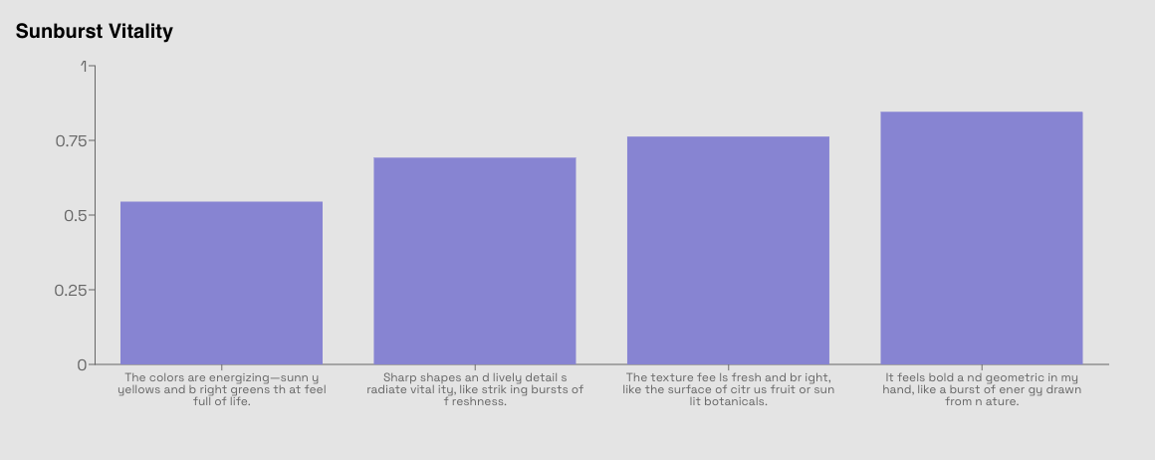
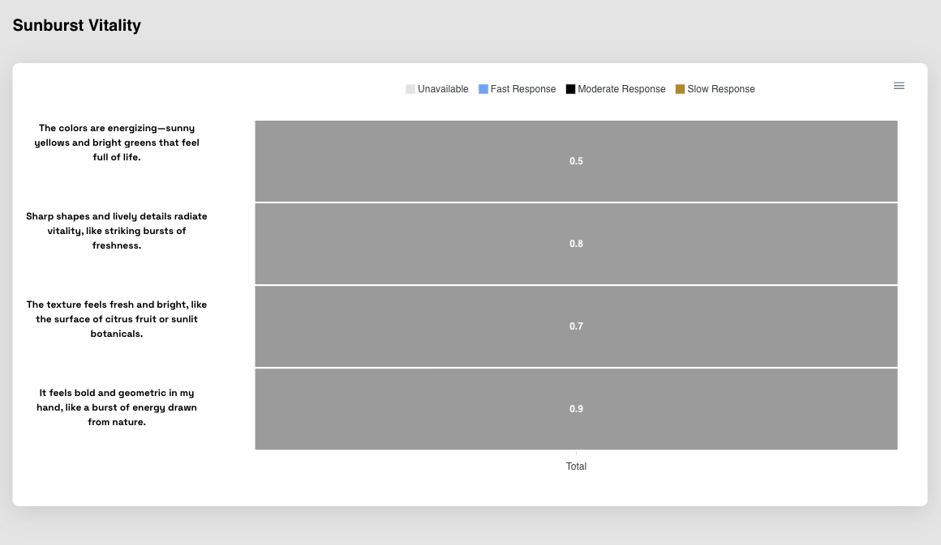
Overall | Response Time
Sunburst Vitality
Key Findings:
• Preferred highest: 0.9 (It feels bold and geometric in my hand, like a burst of energy drawn from nature.)
• Preferred lowest: 0.5 (Least preferred)
• Preferred average: 0.7 (Average)
• Summary: 0.9 performed best in It feels bold and geometric in my hand, like a burst of energy drawn from nature. (Excellent preferred)
© mindgenome.org

Slide 16
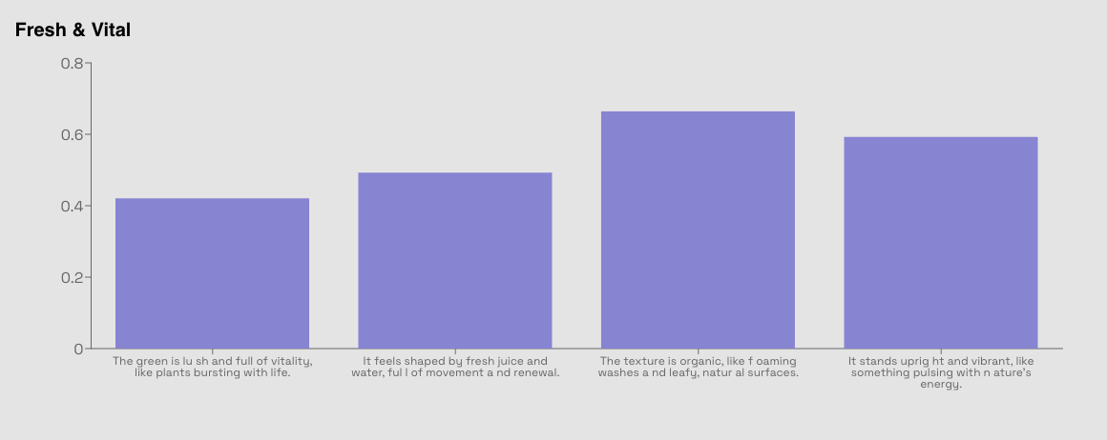
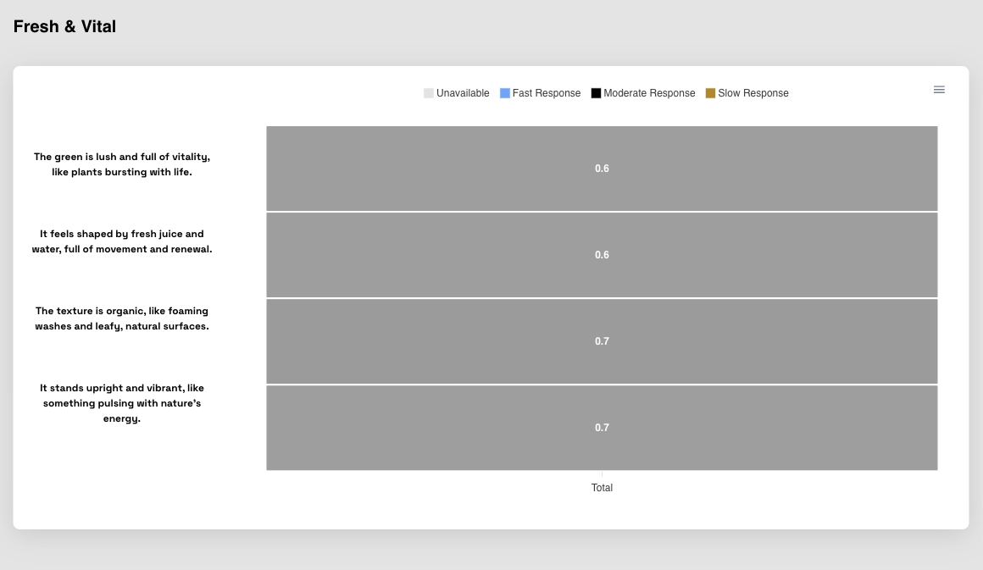
Overall | Response Time
Fresh & Vital
Key Findings:
• Preferred highest: 0.7 (It stands upright and vibrant, like something pulsing with nature’s energy.)
• Preferred lowest: 0.6 (Least preferred)
• Preferred average: 0.6 (Average)
• Summary: 0.7 performed best in It stands upright and vibrant, like something pulsing with nature’s energy. (Excellent preferred)
© mindgenome.org

Slide 17
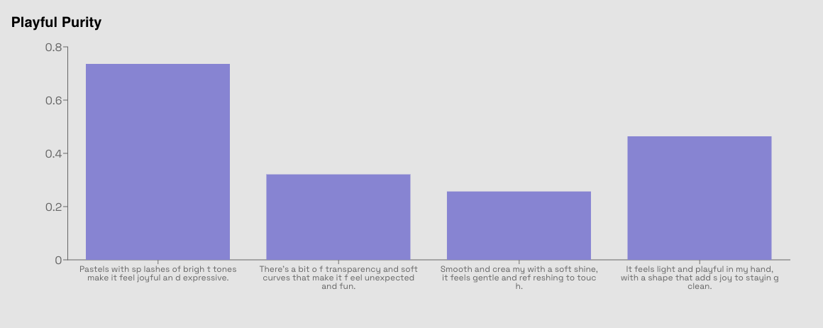
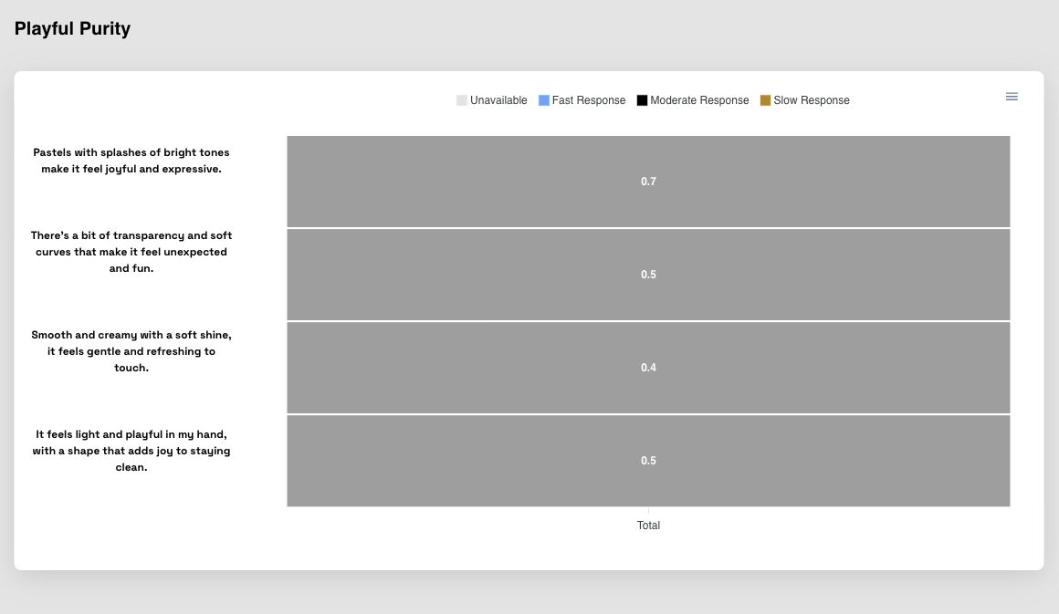
Overall | Response Time
Playful Purity
Key Findings:
• Preferred highest: 0.7 (Pastels with splashes of bright tones make it feel joyful and expressive.)
• Preferred lowest: 0.4 (Least preferred)
• Preferred average: 0.5 (Average)
• Summary: 0.7 performed best in Pastels with splashes of bright tones make it feel joyful and expressive. (Excellent preferred)
© mindgenome.org

Slide 18
Age (Top Down)
Consumer Insights Analysis

Slide 19
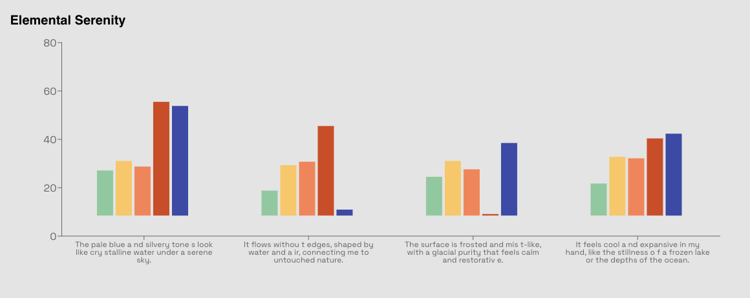
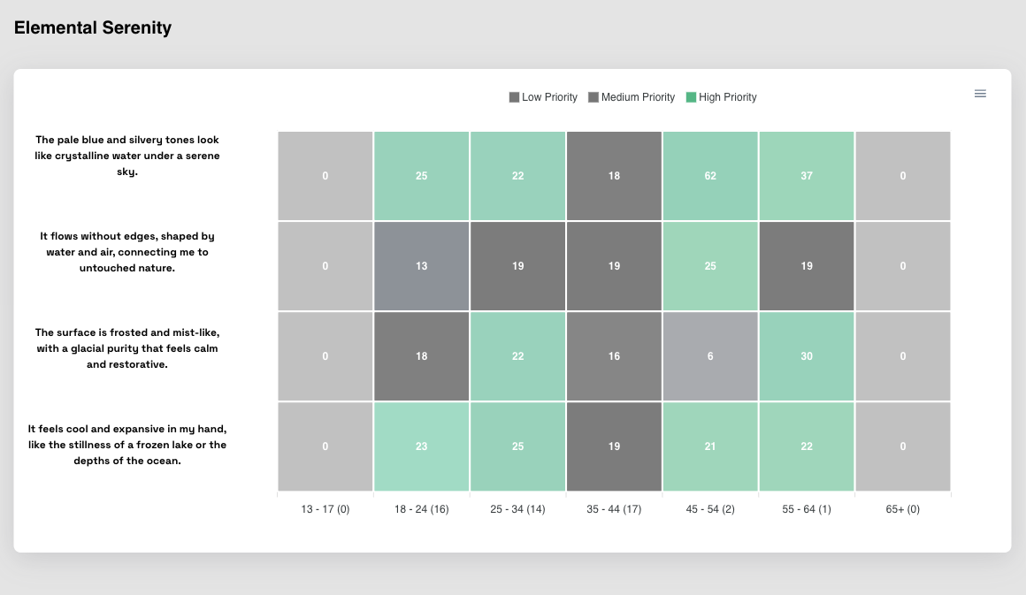
Age | Top Down
Elemental Serenity
Key Findings:
• Preferred highest: 62.0 (Age 45 - 54)
• Preferred lowest: 0.0
• Preferred average: 24.0 (All ages)
• Summary: Age 45 - 54 with score 62.0 performed best (Excellent preferred)
© mindgenome.org

Slide 20
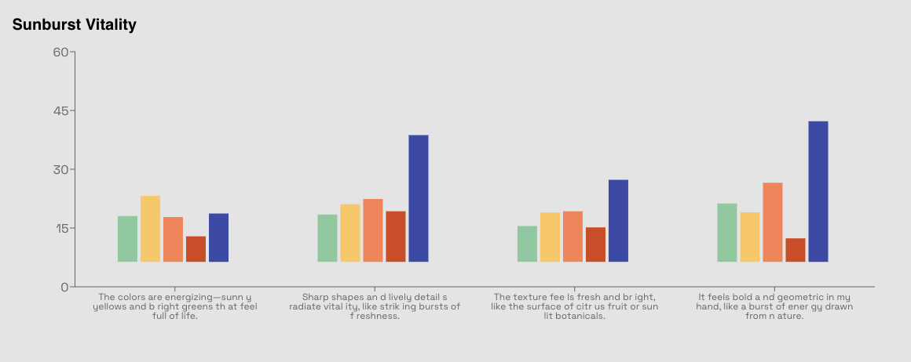
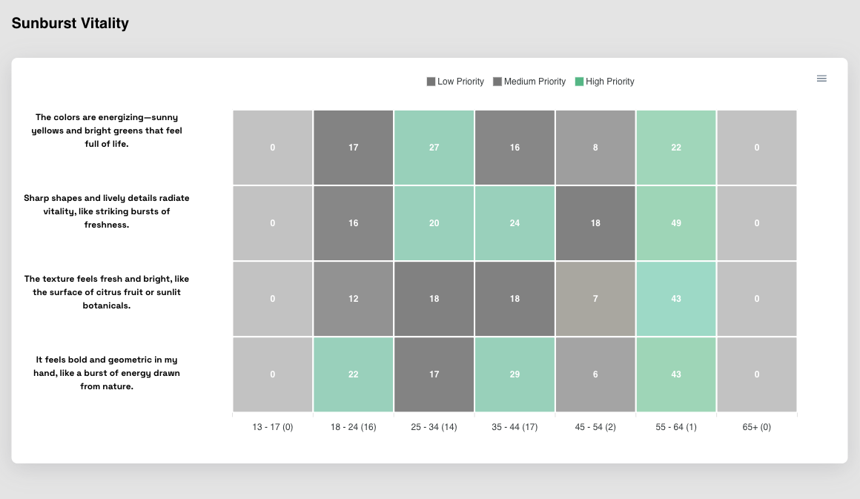
Age | Top Down
Sunburst Vitality
Key Findings:
• Preferred highest: 49.0 (Age 55 - 64)
• Preferred lowest: 0.0
• Preferred average: 20.7 (All ages)
• Summary: Age 55 - 64 with score 49.0 performed best (Excellent preferred)
© mindgenome.org

Slide 21
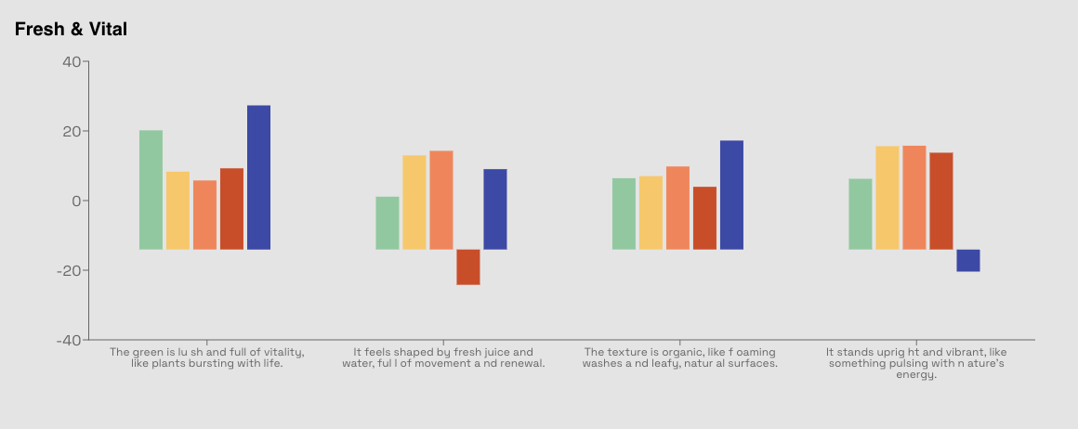
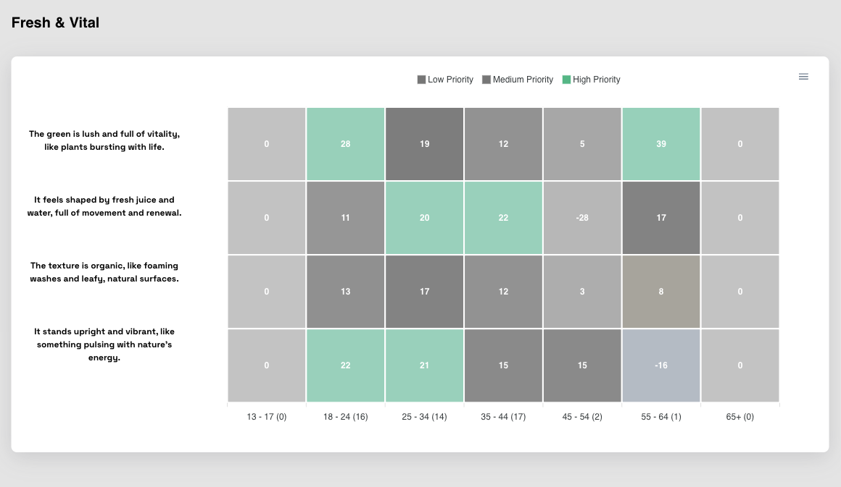
Age | Top Down
Fresh & Vital
Key Findings:
• Preferred highest: 39.0 (Age 55 - 64)
• Preferred lowest: 0.0
• Preferred average: 17.9 (All ages)
• Summary: Age 55 - 64 with score 39.0 performed best (Excellent preferred)
© mindgenome.org

Slide 22
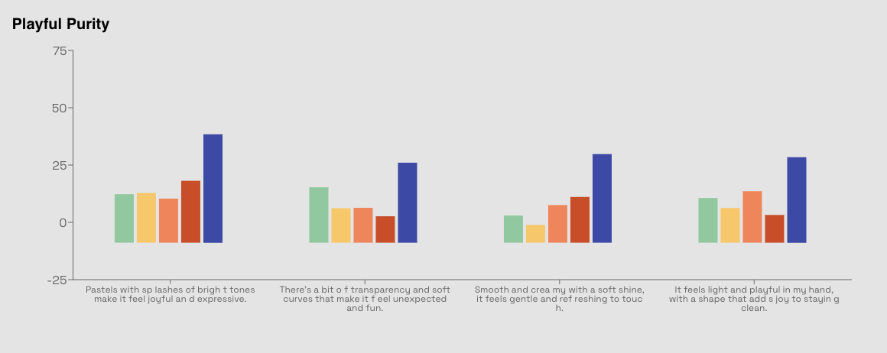
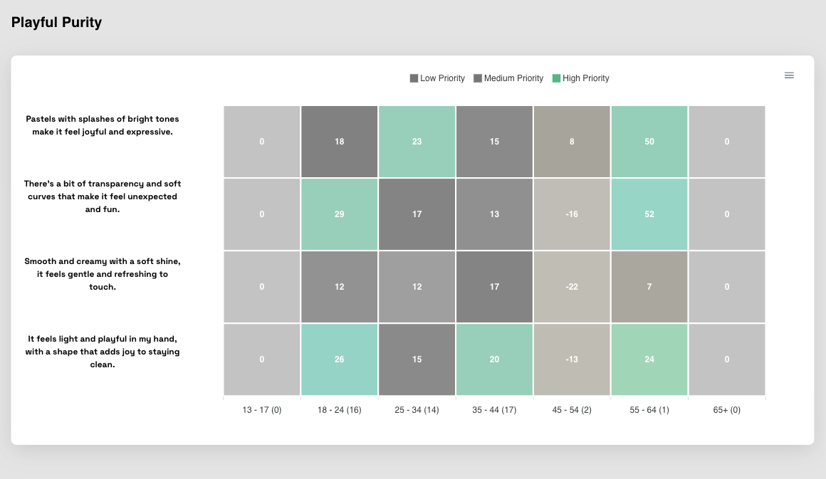
Age | Top Down
Playful Purity
Key Findings:
• Preferred highest: 52.0 (Age 55 - 64)
• Preferred lowest: 0.0
• Preferred average: 18.9 (All ages)
• Summary: Age 55 - 64 with score 52.0 performed best (Excellent preferred)
© mindgenome.org

Slide 23
Age (Bottom Up)
Consumer Insights Analysis

Slide 24
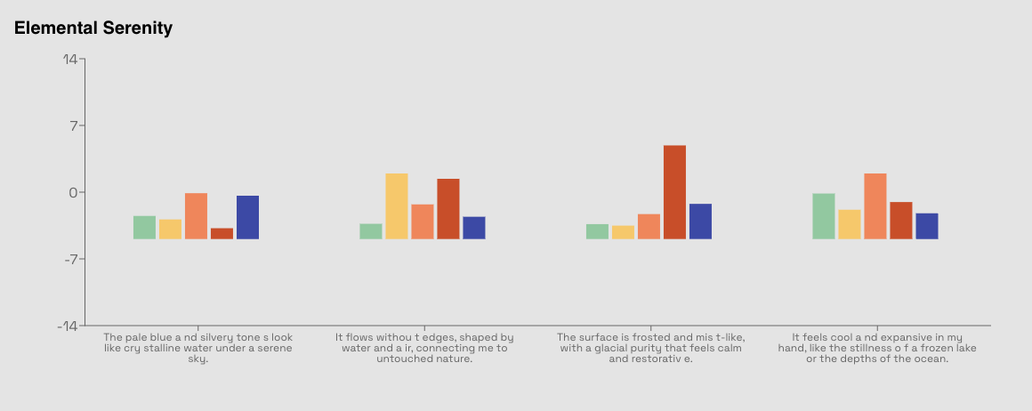
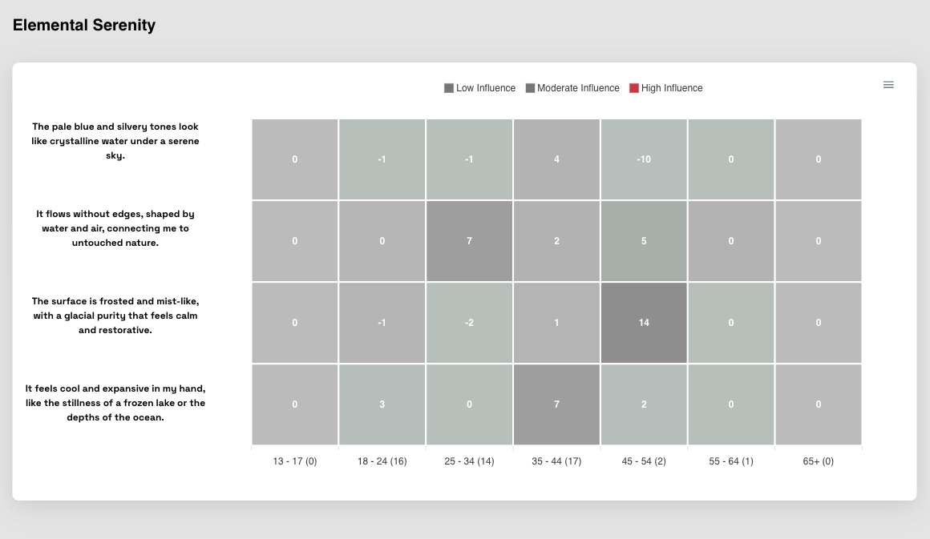
Age | Bottom Up
Elemental Serenity
Key Findings:
• Preferred highest: 14.0 (Age 45 - 54)
• Preferred lowest: 0.0
• Preferred average: 4.4 (All ages)
• Summary: Age 45 - 54 with score 14.0 performed best (Excellent preferred)
© mindgenome.org

Slide 25
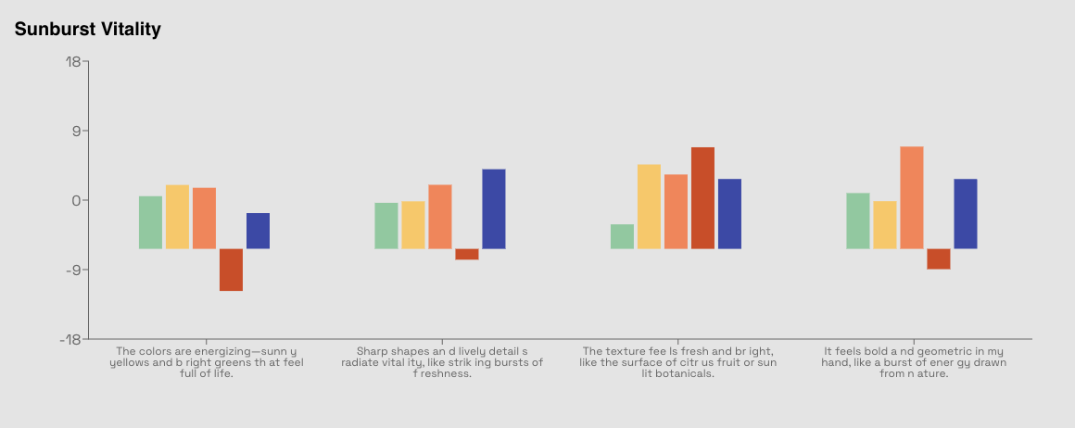
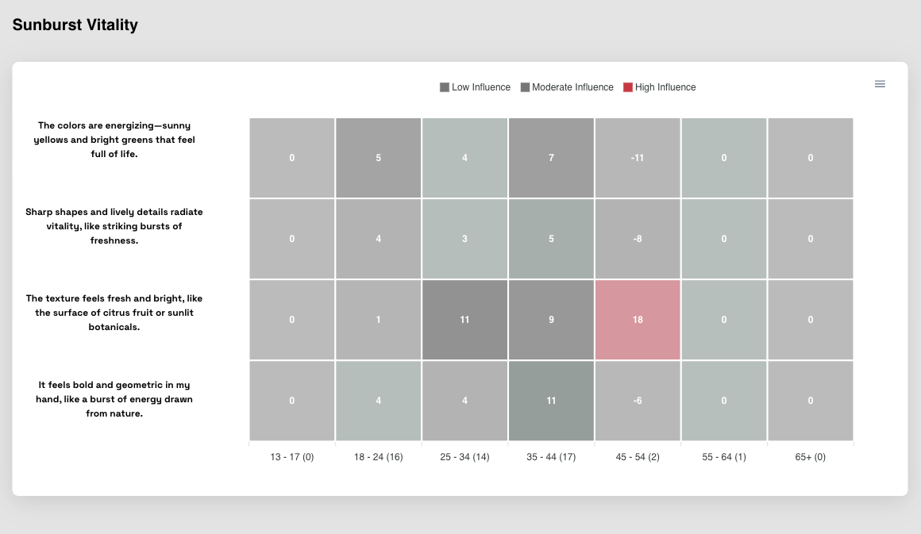
Age | Bottom Up
Sunburst Vitality
Key Findings:
• Preferred highest: 18.0 (Age 45 - 54)
• Preferred lowest: 0.0
• Preferred average: 6.4 (All ages)
• Summary: Age 45 - 54 with score 18.0 performed best (Excellent preferred)
© mindgenome.org

Slide 26
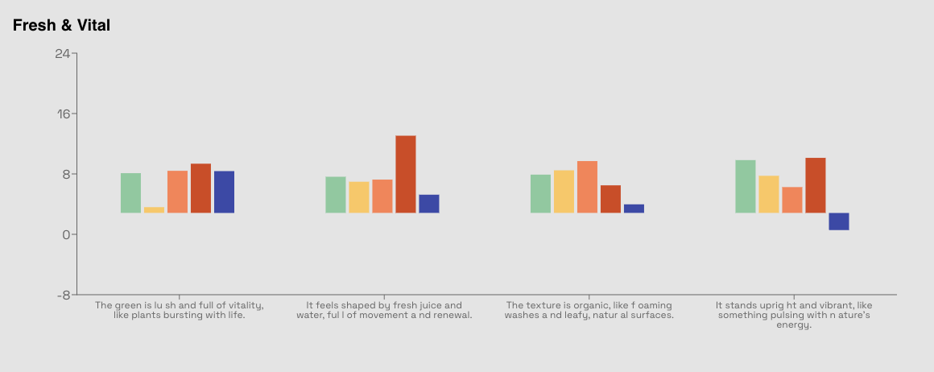
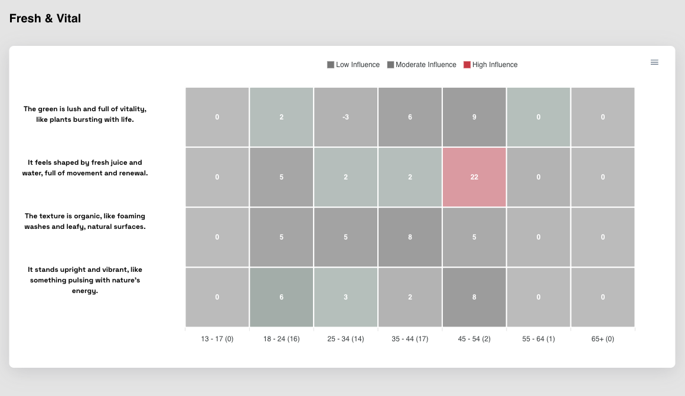
Age | Bottom Up
Fresh & Vital
Key Findings:
• Preferred highest: 22.0 (Age 45 - 54)
• Preferred lowest: 0.0
• Preferred average: 5.9 (All ages)
• Summary: Age 45 - 54 with score 22.0 performed best (Excellent preferred)
© mindgenome.org

Slide 27
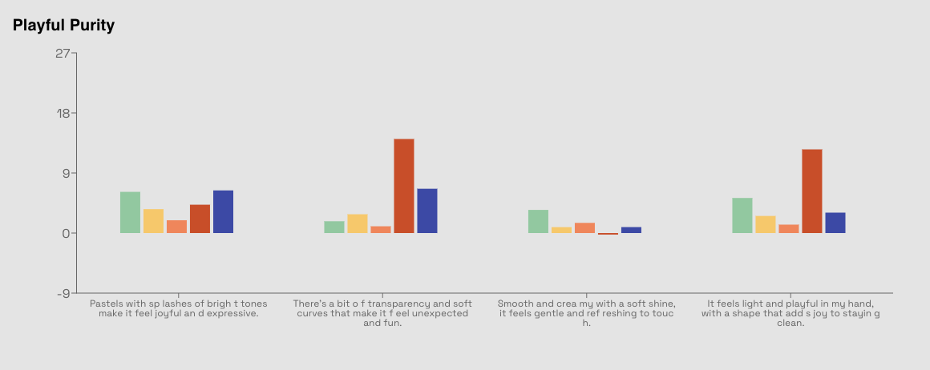
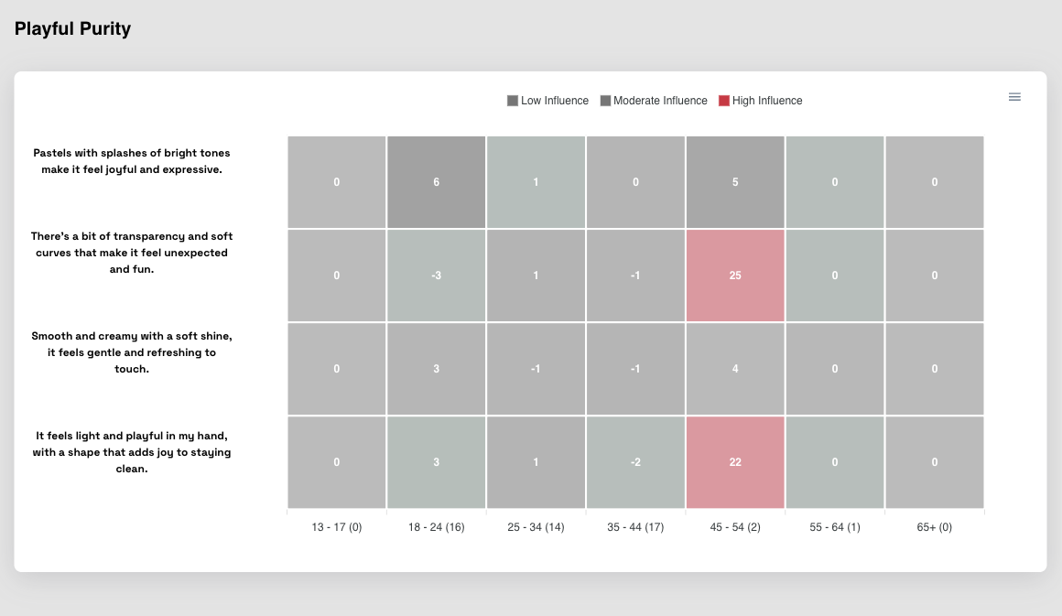
Age | Bottom Up
Playful Purity
Key Findings:
• Preferred highest: 25.0 (Age 45 - 54)
• Preferred lowest: 0.0
• Preferred average: 4.6 (All ages)
• Summary: Age 45 - 54 with score 25.0 performed best (Excellent preferred)
© mindgenome.org

Slide 28
Age (Response Time)
Consumer Insights Analysis

Slide 29
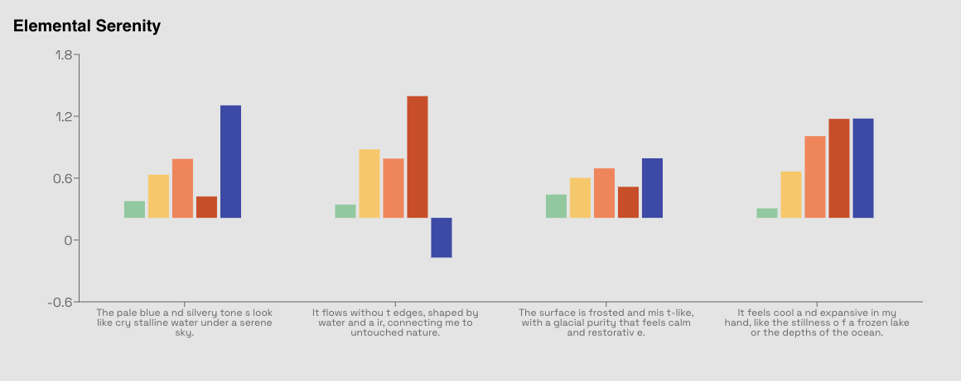
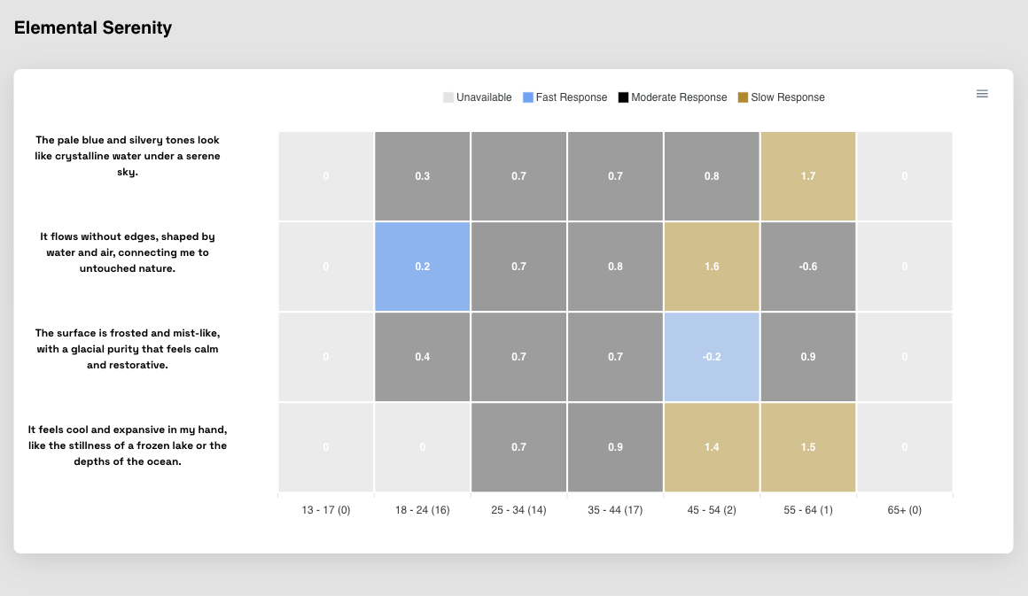
Age | Response Time
Elemental Serenity
Key Findings:
• Preferred highest: 1.7 (Age 55 - 64)
• Preferred lowest: 0.0
• Preferred average: 0.8 (All ages)
• Summary: Age 55 - 64 with score 1.7 performed best (Excellent preferred)
© mindgenome.org

Slide 30
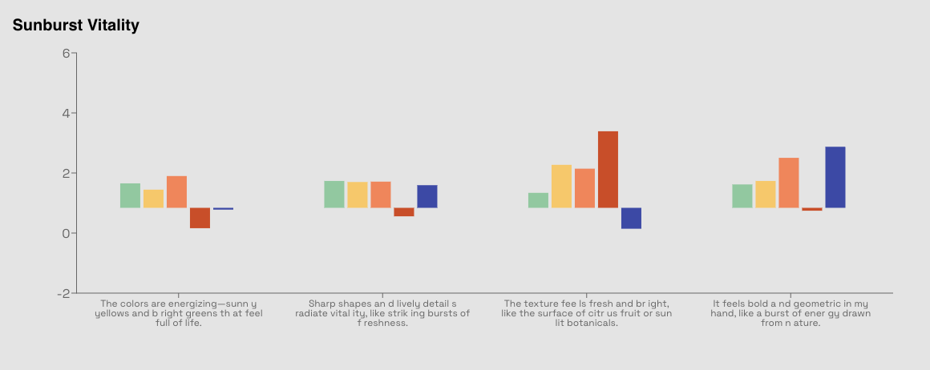
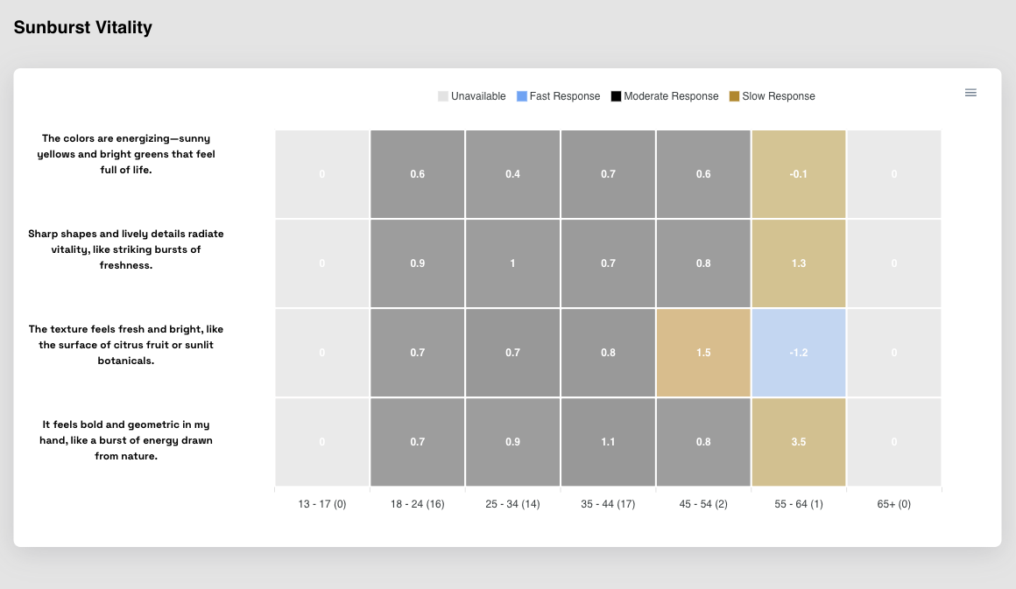
Age | Response Time
Sunburst Vitality
Key Findings:
• Preferred highest: 3.5 (Age 55 - 64)
• Preferred lowest: 0.0
• Preferred average: 1.1 (All ages)
• Summary: Age 55 - 64 with score 3.5 performed best (Excellent preferred)
© mindgenome.org

Slide 31
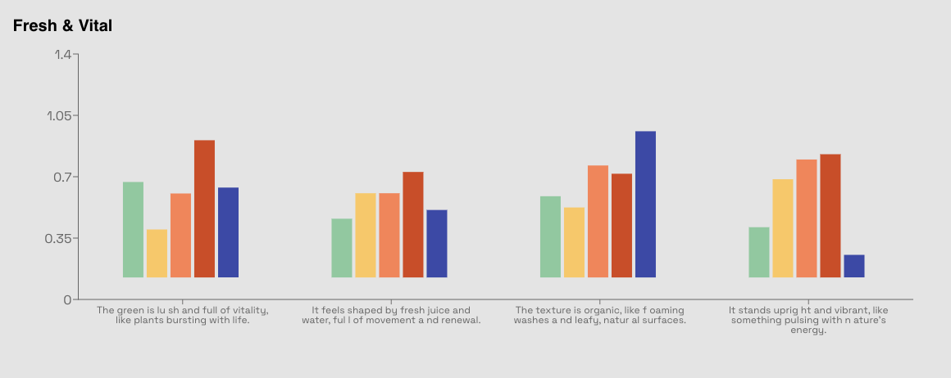
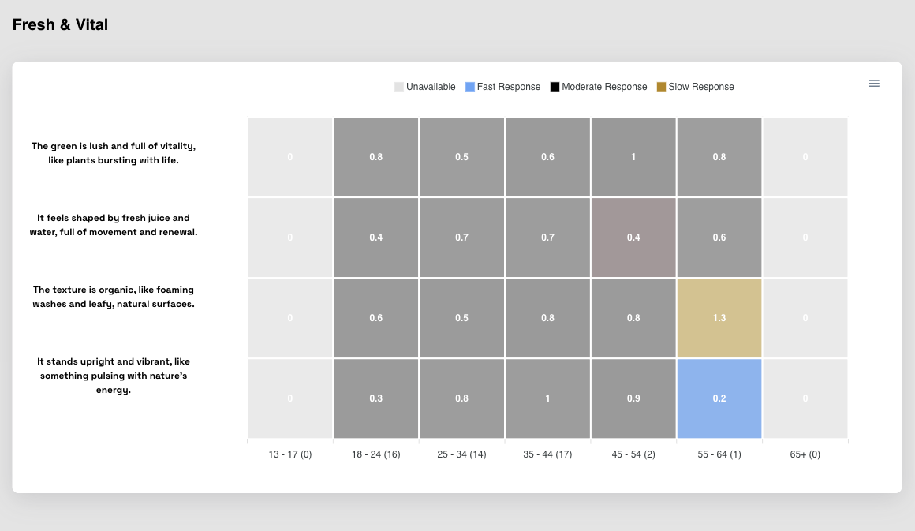
Age | Response Time
Fresh & Vital
Key Findings:
• Preferred highest: 1.3 (Age 55 - 64)
• Preferred lowest: 0.0
• Preferred average: 0.7 (All ages)
• Summary: Age 55 - 64 with score 1.3 performed best (Excellent preferred)
© mindgenome.org

Slide 32
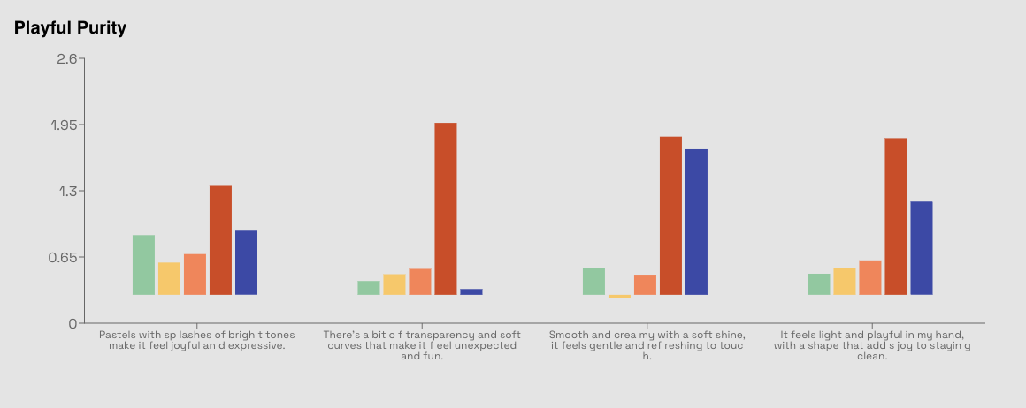
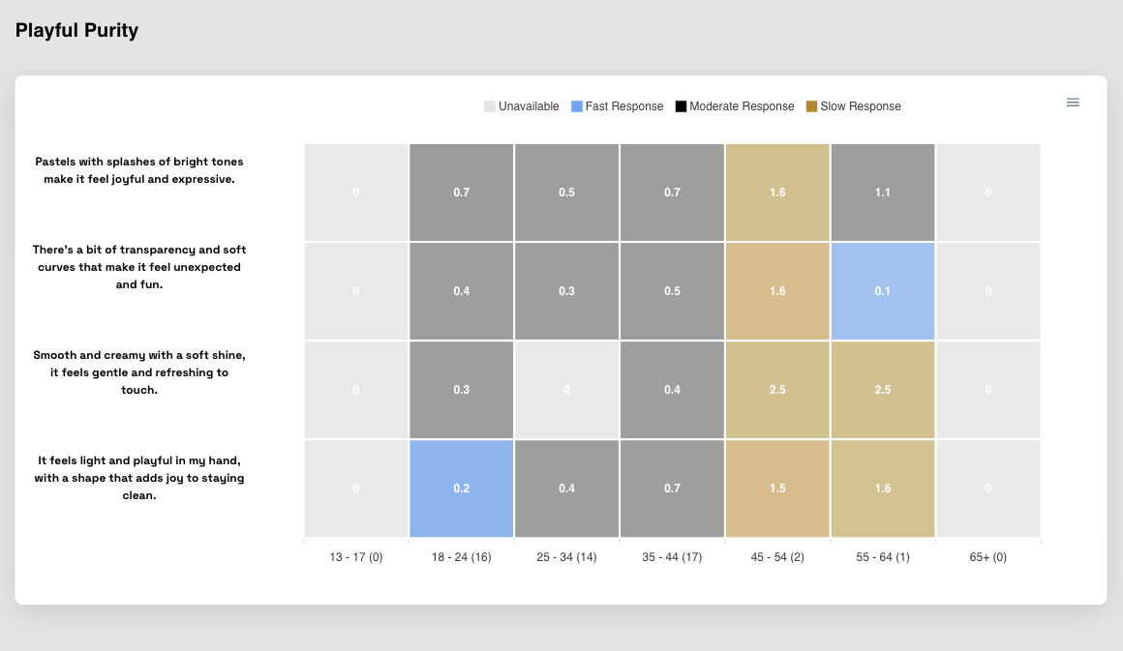
Age | Response Time
Playful Purity
Key Findings:
• Preferred highest: 2.5 (Age 45 - 54)
• Preferred lowest: 0.0
• Preferred average: 1.0 (All ages)
• Summary: Age 45 - 54 with score 2.5 performed best (Excellent preferred)
© mindgenome.org

Slide 33
Gender (Top Down)
Consumer Insights Analysis

Slide 34
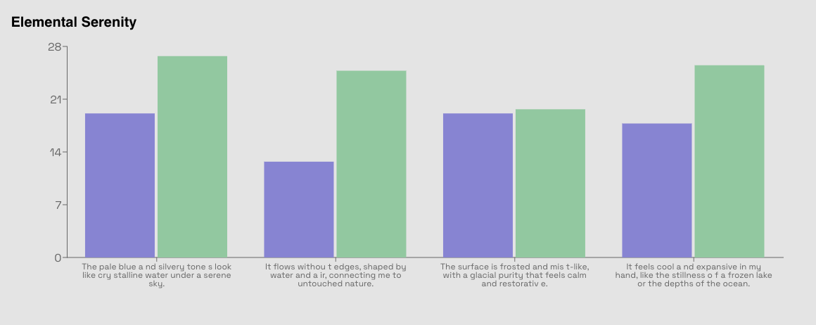
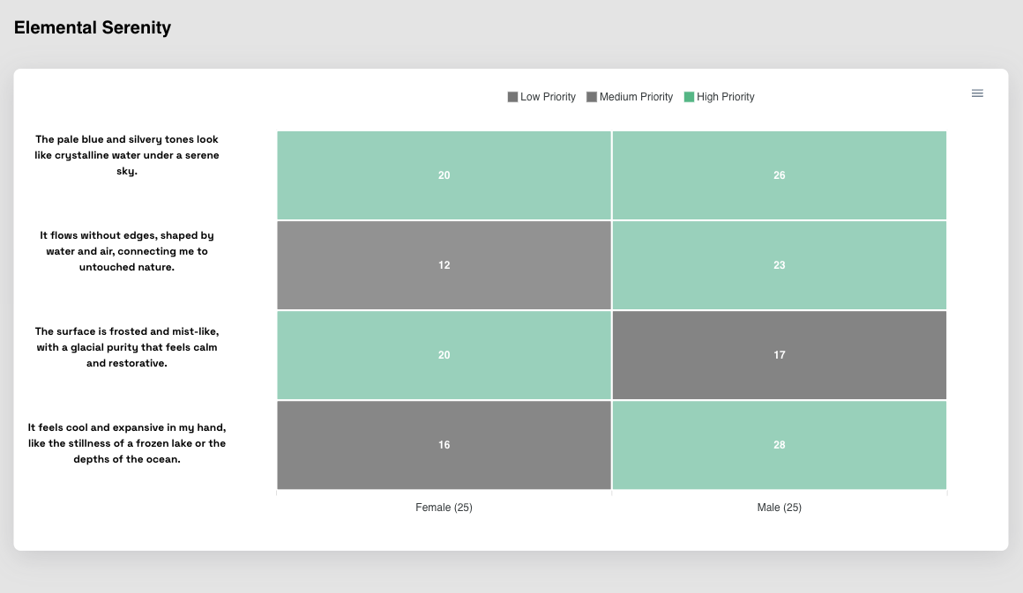
Gender | Top Down
Elemental Serenity
Key Findings:
• Preferred highest: 28.0 (Male)
• Preferred lowest: 20.0
• Preferred average: 24.0 (Both genders)
• Summary: Male with score 28.0 performed best (Excellent preferred)
© mindgenome.org

Slide 35


Gender | Top Down
Sunburst Vitality
Key Findings:
• Preferred highest: 23.0 (Female)
• Preferred lowest: 23.0
• Preferred average: 23.0 (Both genders)
• Summary: Female with score 23.0 performed best (Excellent preferred)
© mindgenome.org

Slide 36


Gender | Top Down
Fresh & Vital
Key Findings:
• Preferred highest: 20.0 (Female)
• Preferred lowest: 18.0
• Preferred average: 19.0 (Both genders)
• Summary: Female with score 20.0 performed best (Excellent preferred)
© mindgenome.org

Slide 37


Gender | Top Down
Playful Purity
Key Findings:
• Preferred highest: 23.0 (Female)
• Preferred lowest: 17.0
• Preferred average: 20.0 (Both genders)
• Summary: Female with score 23.0 performed best (Excellent preferred)
© mindgenome.org

Slide 38
Gender (Bottom Up)
Consumer Insights Analysis

Slide 39


Gender | Bottom Up
Elemental Serenity
Key Findings:
• Preferred highest: 6.0 (Female)
• Preferred lowest: 1.0
• Preferred average: 3.5 (Both genders)
• Summary: Female with score 6.0 performed best (Excellent preferred)
© mindgenome.org

Slide 40


Gender | Bottom Up
Sunburst Vitality
Key Findings:
• Preferred highest: 9.0 (Female)
• Preferred lowest: 7.0
• Preferred average: 8.0 (Both genders)
• Summary: Female with score 9.0 performed best (Excellent preferred)
© mindgenome.org

Slide 41


Gender | Bottom Up
Fresh & Vital
Key Findings:
• Preferred highest: 7.0 (Female)
• Preferred lowest: 6.0
• Preferred average: 6.5 (Both genders)
• Summary: Female with score 7.0 performed best (Excellent preferred)
© mindgenome.org

Slide 42


Gender | Bottom Up
Playful Purity
Key Findings:
• Preferred highest: 5.0 (Male)
• Preferred lowest: 0.0
• Preferred average: 2.5 (Both genders)
• Summary: Male with score 5.0 performed best (Excellent preferred)
© mindgenome.org

Slide 43
Gender (Response Time)
Consumer Insights Analysis

Slide 44


Gender | Response Time
Elemental Serenity
Key Findings:
• Preferred highest: 0.8 (Male)
• Preferred lowest: 0.6
• Preferred average: 0.7 (Both genders)
• Summary: Male with score 0.8 performed best (Excellent preferred)
© mindgenome.org

Slide 45


Gender | Response Time
Sunburst Vitality
Key Findings:
• Preferred highest: 1.1 (Female)
• Preferred lowest: 0.9
• Preferred average: 1.0 (Both genders)
• Summary: Female with score 1.1 performed best (Excellent preferred)
© mindgenome.org

Slide 46


Gender | Response Time
Fresh & Vital
Key Findings:
• Preferred highest: 0.9 (Male)
• Preferred lowest: 0.6
• Preferred average: 0.8 (Both genders)
• Summary: Male with score 0.9 performed best (Excellent preferred)
© mindgenome.org

Slide 47


Gender | Response Time
Playful Purity
Key Findings:
• Preferred highest: 0.7 (Female)
• Preferred lowest: 0.7
• Preferred average: 0.7 (Both genders)
• Summary: Female with score 0.7 performed best (Excellent preferred)
© mindgenome.org

Slide 48
Prelim (Top Down)
Consumer Insights Analysis

Slide 49


Prelim | Top Down
Elemental Serenity
Key Findings:
• Preferred highest: 44.0 ('Lotion/Cream')
• Preferred lowest: 21.0
• Preferred average: 27.6 (All segments)
• Summary: 'Lotion/Cream' with score 44.0 performed best (Excellent preferred)
© mindgenome.org

Slide 50


Prelim | Top Down
Sunburst Vitality
Key Findings:
• Preferred highest: 40.0 ('Lotion/Cream')
• Preferred lowest: 20.0
• Preferred average: 27.8 (All segments)
• Summary: 'Lotion/Cream' with score 40.0 performed best (Excellent preferred)
© mindgenome.org

Slide 51


Prelim | Top Down
Fresh & Vital
Key Findings:
• Preferred highest: 40.0 ('Lotion/Cream')
• Preferred lowest: 18.0
• Preferred average: 23.0 (All segments)
• Summary: 'Lotion/Cream' with score 40.0 performed best (Excellent preferred)
© mindgenome.org

Slide 52


Prelim | Top Down
Playful Purity
Key Findings:
• Preferred highest: 30.0 ('Lotion/Cream')
• Preferred lowest: 18.0
• Preferred average: 22.2 (All segments)
• Summary: 'Lotion/Cream' with score 30.0 performed best (Excellent preferred)
© mindgenome.org

Slide 53
Prelim (Bottom Up)
Consumer Insights Analysis

Slide 54


Prelim | Bottom Up
Elemental Serenity
Key Findings:
• Preferred highest: 7.0 ('Odor protection')
• Preferred lowest: 2.0
• Preferred average: 4.1 (All segments)
• Summary: 'Odor protection' with score 7.0 performed best (Excellent preferred)
© mindgenome.org

Slide 55


Prelim | Bottom Up
Sunburst Vitality
Key Findings:
• Preferred highest: 15.0 ('Skin care benefits')
• Preferred lowest: 1.0
• Preferred average: 7.3 (All segments)
• Summary: 'Skin care benefits' with score 15.0 performed best (Excellent preferred)
© mindgenome.org

Slide 56


Prelim | Bottom Up
Fresh & Vital
Key Findings:
• Preferred highest: 13.0 ('Skin care benefits')
• Preferred lowest: 5.0
• Preferred average: 7.6 (All segments)
• Summary: 'Skin care benefits' with score 13.0 performed best (Excellent preferred)
© mindgenome.org

Slide 57


Prelim | Bottom Up
Playful Purity
Key Findings:
• Preferred highest: 12.0 ('Roll-on')
• Preferred lowest: 1.0
• Preferred average: 4.2 (All segments)
• Summary: 'Roll-on' with score 12.0 performed best (Excellent preferred)
© mindgenome.org

Slide 58
Prelim (Response Time)
Consumer Insights Analysis

Slide 59


Prelim | Response Time
Elemental Serenity
Key Findings:
• Preferred highest: 3.2 ('Lotion/Cream')
• Preferred lowest: 0.2
• Preferred average: 1.0 (All segments)
• Summary: 'Lotion/Cream' with score 3.2 performed best (Excellent preferred)
© mindgenome.org

Slide 60


Prelim | Response Time
Sunburst Vitality
Key Findings:
• Preferred highest: 1.7 ('Spray')
• Preferred lowest: 0.8
• Preferred average: 1.1 (All segments)
• Summary: 'Spray' with score 1.7 performed best (Excellent preferred)
© mindgenome.org

Slide 61


Prelim | Response Time
Fresh & Vital
Key Findings:
• Preferred highest: 2.6 ('Lotion/Cream')
• Preferred lowest: 0.2
• Preferred average: 0.9 (All segments)
• Summary: 'Lotion/Cream' with score 2.6 performed best (Excellent preferred)
© mindgenome.org

Slide 62


Prelim | Response Time
Playful Purity
Key Findings:
• Preferred highest: 2.9 ('Lotion/Cream')
• Preferred lowest: 0.1
• Preferred average: 1.0 (All segments)
• Summary: 'Lotion/Cream' with score 2.9 performed best (Excellent preferred)
© mindgenome.org

Slide 63
2 Market Segments (Top Down)
Consumer Insights Analysis

Slide 64


2 Market Segments | Top Down
Elemental Serenity
Key Findings:
• Preferred highest: 24.0 (Mindset 1 of 2)
• Preferred lowest: 24.0
• Preferred average: 24.0
• Summary: Mindset 1 of 2 performed best in this group
© mindgenome.org

Slide 65


2 Market Segments | Top Down
Sunburst Vitality
Key Findings:
• Preferred highest: 28.0 (Mindset 1 of 2)
• Preferred lowest: 18.0
• Preferred average: 23.0
• Summary: Mindset 1 of 2 performed best in this group
© mindgenome.org

Slide 66


2 Market Segments | Top Down
Fresh & Vital
Key Findings:
• Preferred highest: 20.0 (Mindset 2 of 2)
• Preferred lowest: 19.0
• Preferred average: 19.5
• Summary: Mindset 2 of 2 performed best in this group
© mindgenome.org

Slide 67


2 Market Segments | Top Down
Playful Purity
Key Findings:
• Preferred highest: 27.0 (Mindset 1 of 2)
• Preferred lowest: 13.0
• Preferred average: 20.0
• Summary: Mindset 1 of 2 performed best in this group
© mindgenome.org

Slide 68
2 Market Segments (Bottom Up)
Consumer Insights Analysis

Slide 69


2 Market Segments | Bottom Up
Elemental Serenity
Key Findings:
• Preferred highest: 8.0 (Mindset 2 of 2)
• Preferred lowest: 3.0
• Preferred average: 5.5
• Summary: Mindset 2 of 2 performed best in this group
© mindgenome.org

Slide 70


2 Market Segments | Bottom Up
Sunburst Vitality
Key Findings:
• Preferred highest: 10.0 (Mindset 2 of 2)
• Preferred lowest: 9.0
• Preferred average: 9.5
• Summary: Mindset 2 of 2 performed best in this group
© mindgenome.org

Slide 71


2 Market Segments | Bottom Up
Fresh & Vital
Key Findings:
• Preferred highest: 11.0 (Mindset 1 of 2)
• Preferred lowest: 2.0
• Preferred average: 6.5
• Summary: Mindset 1 of 2 performed best in this group
© mindgenome.org

Slide 72


2 Market Segments | Bottom Up
Playful Purity
Key Findings:
• Preferred highest: 7.0 (Mindset 2 of 2)
• Preferred lowest: 7.0
• Preferred average: 7.0
• Summary: Mindset 2 of 2 performed best in this group
© mindgenome.org

Slide 73
2 Market Segments (Response Time)
Consumer Insights Analysis

Slide 74


2 Market Segments | Response Time
Elemental Serenity
Key Findings:
• Preferred highest: 0.8 (Mindset 1 of 2)
• Preferred lowest: 0.6
• Preferred average: 0.7
• Summary: Mindset 1 of 2 performed best in this group
© mindgenome.org

Slide 75


2 Market Segments | Response Time
Sunburst Vitality
Key Findings:
• Preferred highest: 1.0 (Mindset 2 of 2)
• Preferred lowest: 0.9
• Preferred average: 0.9
• Summary: Mindset 2 of 2 performed best in this group
© mindgenome.org

Slide 76


2 Market Segments | Response Time
Fresh & Vital
Key Findings:
• Preferred highest: 0.9 (Mindset 2 of 2)
• Preferred lowest: 0.7
• Preferred average: 0.8
• Summary: Mindset 2 of 2 performed best in this group
© mindgenome.org

Slide 77


2 Market Segments | Response Time
Playful Purity
Key Findings:
• Preferred highest: 0.8 (Mindset 2 of 2)
• Preferred lowest: 0.6
• Preferred average: 0.7
• Summary: Mindset 2 of 2 performed best in this group
© mindgenome.org

Slide 78
3 Market Segments (Top Down)
Consumer Insights Analysis

Slide 79


3 Market Segments | Top Down
Elemental Serenity
Key Findings:
• Preferred highest: 37.0 (Mindset 3 of 3)
• Preferred lowest: 20.0
• Preferred average: 28.3
• Summary: Mindset 3 of 3 performed best in this group
© mindgenome.org

Slide 80


3 Market Segments | Top Down
Sunburst Vitality
Key Findings:
• Preferred highest: 31.0 (Mindset 1 of 3)
• Preferred lowest: 17.0
• Preferred average: 25.0
• Summary: Mindset 1 of 3 performed best in this group
© mindgenome.org

Slide 81


3 Market Segments | Top Down
Fresh & Vital
Key Findings:
• Preferred highest: 32.0 (Mindset 2 of 3)
• Preferred lowest: 16.0
• Preferred average: 22.7
• Summary: Mindset 2 of 3 performed best in this group
© mindgenome.org

Slide 82


3 Market Segments | Top Down
Playful Purity
Key Findings:
• Preferred highest: 27.0 (Mindset 1 of 3)
• Preferred lowest: 11.0
• Preferred average: 19.7
• Summary: Mindset 1 of 3 performed best in this group
© mindgenome.org

Slide 83
3 Market Segments (Bottom Up)
Consumer Insights Analysis

Slide 84


3 Market Segments | Bottom Up
Elemental Serenity
Key Findings:
• Preferred highest: 7.0 (Mindset 2 of 3)
• Preferred lowest: 3.0
• Preferred average: 4.7
• Summary: Mindset 2 of 3 performed best in this group
© mindgenome.org

Slide 85


3 Market Segments | Bottom Up
Sunburst Vitality
Key Findings:
• Preferred highest: 9.0 (Mindset 3 of 3)
• Preferred lowest: 7.0
• Preferred average: 7.7
• Summary: Mindset 3 of 3 performed best in this group
© mindgenome.org

Slide 86


3 Market Segments | Bottom Up
Fresh & Vital
Key Findings:
• Preferred highest: 13.0 (Mindset 1 of 3)
• Preferred lowest: 8.0
• Preferred average: 10.5
• Summary: Mindset 1 of 3 performed best in this group
© mindgenome.org

Slide 87


3 Market Segments | Bottom Up
Playful Purity
Key Findings:
• Preferred highest: 9.0 (Mindset 3 of 3)
• Preferred lowest: 6.0
• Preferred average: 7.5
• Summary: Mindset 3 of 3 performed best in this group
© mindgenome.org

Slide 88
3 Market Segments (Response Time)
Consumer Insights Analysis

Slide 89


3 Market Segments | Response Time
Elemental Serenity
Key Findings:
• Preferred highest: 0.9 (Mindset 3 of 3)
• Preferred lowest: 0.7
• Preferred average: 0.8
• Summary: Mindset 3 of 3 performed best in this group
© mindgenome.org

Slide 90


3 Market Segments | Response Time
Sunburst Vitality
Key Findings:
• Preferred highest: 1.2 (Mindset 2 of 3)
• Preferred lowest: 0.6
• Preferred average: 0.9
• Summary: Mindset 2 of 3 performed best in this group
© mindgenome.org

Slide 91


3 Market Segments | Response Time
Fresh & Vital
Key Findings:
• Preferred highest: 1.1 (Mindset 2 of 3)
• Preferred lowest: 0.6
• Preferred average: 0.9
• Summary: Mindset 2 of 3 performed best in this group
© mindgenome.org

Slide 92


3 Market Segments | Response Time
Playful Purity
Key Findings:
• Preferred highest: 0.8 (Mindset 2 of 3)
• Preferred lowest: 0.5
• Preferred average: 0.7
• Summary: Mindset 2 of 3 performed best in this group
© mindgenome.org

